Slide 1
Living with Multiple chronic conditions
dr. h.c. Cees Smit, European Patients Forum (EPF), LUMC, dept Epidemiology
World Health Assembly, Geneva, May 20, 2019

Slide 2
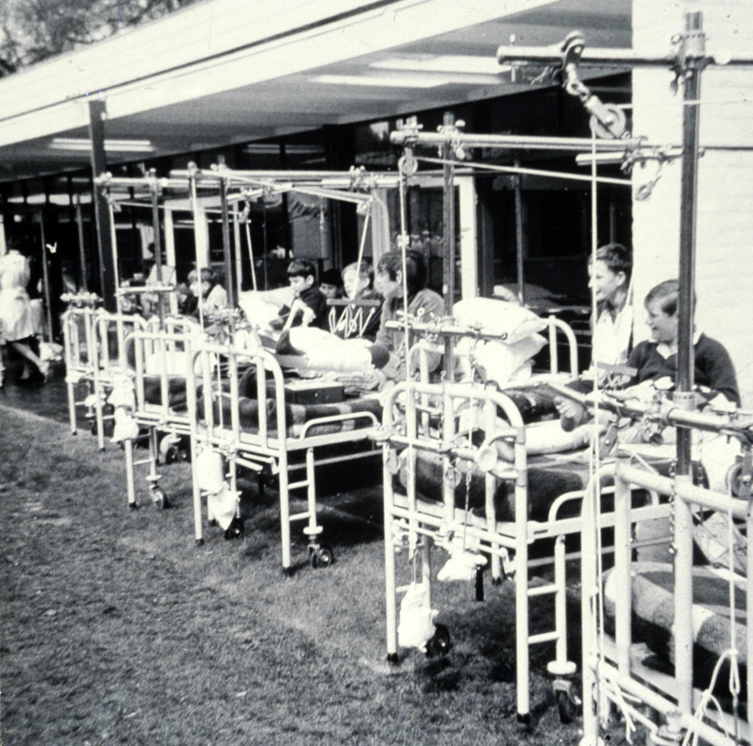
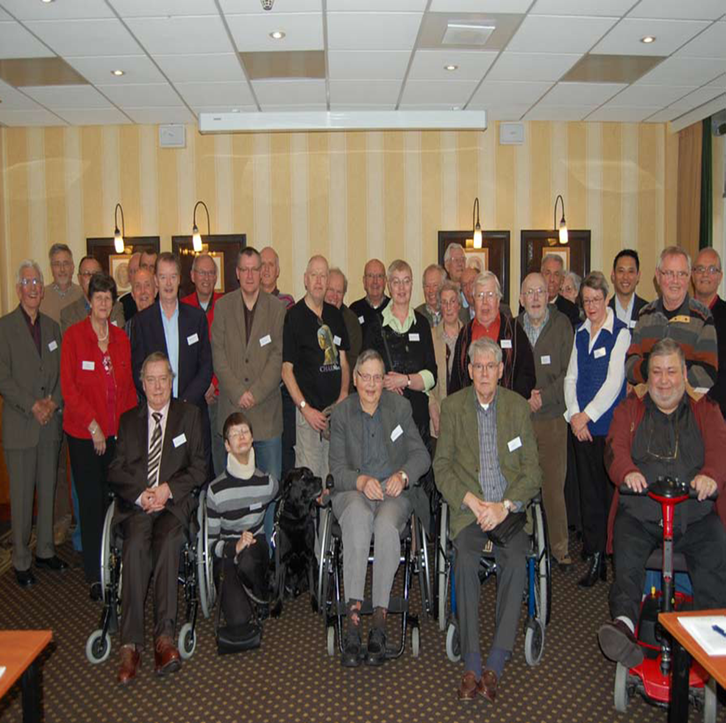
Medical Progress in haemophilia
1965 2015
2015

Slide 3
Circle of health care contacts

Slide 5
The ‘fear’ Factor
Three problems:
Comorbidity & the use of multiple medications (polyfarmacy)
Lack of coordination between physicians and other para/medical persons. This requires a lot of self-management (‘eigen regie’)
Who can and want to take over self-management if you cannot do that yourself anymore?
And who perceives this problem at an early stage?

Slide 6
the problems of comorbidiity
Functional limitations Social limitation
Physical deterioration, fatigue Lack of understanding
Less ability for self-care Decrease of social contacts
Psychological complaints/symptoms Societal problems
Fear and depression Less participation in labour and leisure activities
Feeling of losing control An increase of disease costs

